Slide 1



A Playdate Platform for Parents to Explore Activities
Making it simple for parents to find great playdate opportunities for their children.
Making it easier for kids to socialize and for families to enjoy time together.
by Becky Jin

Slide 2

The Need for Family-Friendly Community
In today’s fast-paced world, where work-life balance is often a challenge, parents are increasingly seeking ways to enrich their children's lives through social interaction and engaging activities.
Even though parents want their children to socialize, planning successful playdates can be harder than it seems.
To solve these problems, this project aims to create a platform called MiniMates, which simplifies the process of planning playdates.

Slide 3

Highlighted Features
Explore Activities
Chatting
Parents can easily discover different kind of activities and events in their area.
Minimates allows parents to chat with the other authors to know more about the activities.
Gemini AI recommandations
Minimates can generate activities list based on the user preferences which can be selected in the preference section, integrating Gemini to give parents playdate recommandations.

Slide 4





Technologies
FrontEnd
BackEnd
DataBase
Flutter
Firebase
Firestore

Slide 5

Changes to proposal
Original
Final
Reason
Kids Matching Feature
No kids matching
Privacy concerns
Text-based locations
Switched to using geolocation (lat/lng) and Google Maps
Improves accuracy and context
No comment section
Added threaded replies and likes on comments
Better social interaction
No chatting
Added chatting feature
Better connection
Data analysis
No analysis and Integrated Gemini AI to enhance suggestions
The hardness of preparing the data, and do the data analysis

Slide 6

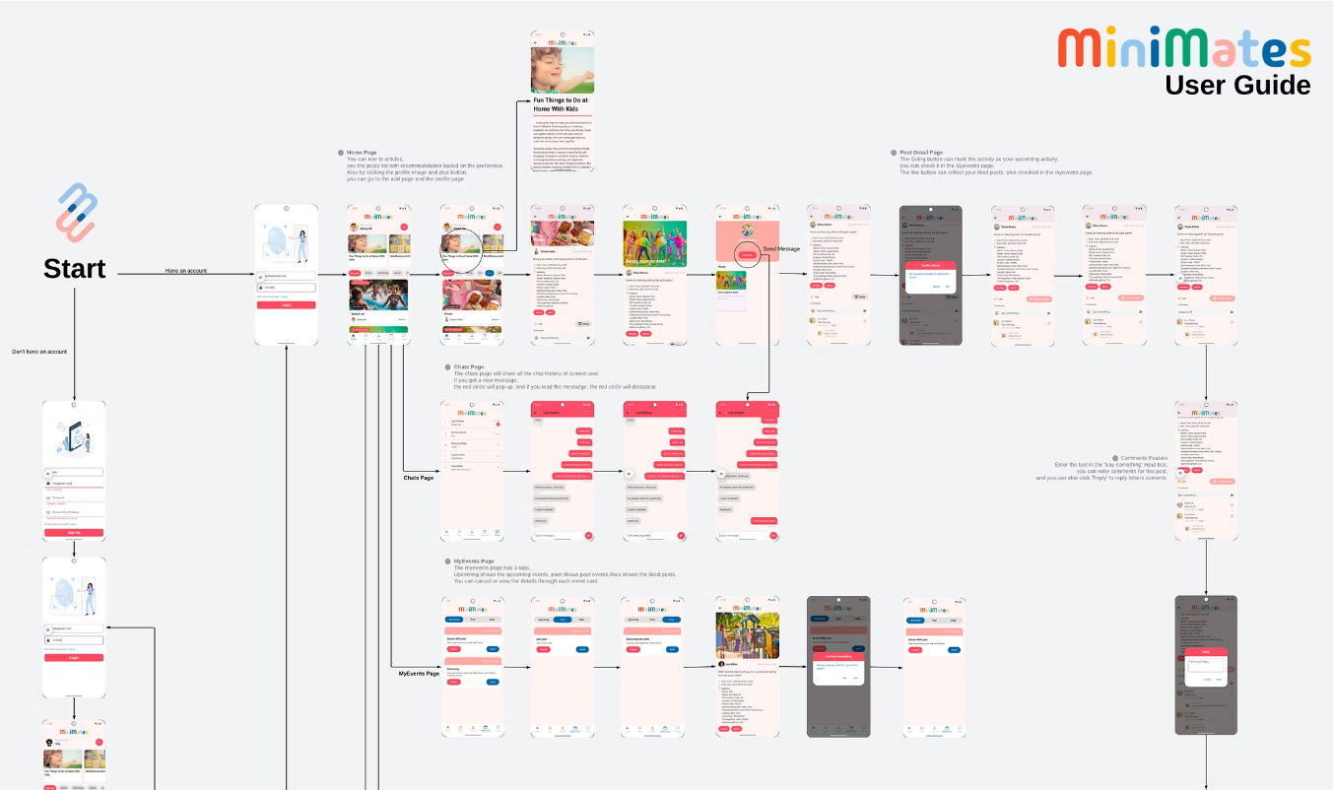
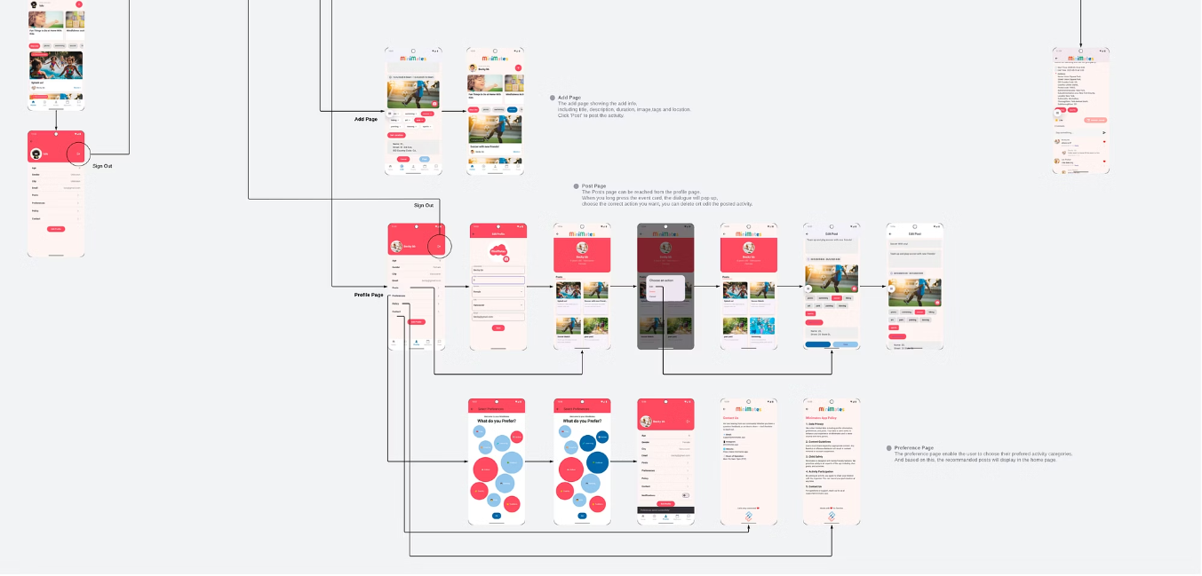
User Guide
This app includes five main sections, they are home page, add page, myevents page, profile page and chats page.
The user guide will guide the user explore the minimates step by step.

Slide 7

Evaluation Techniques
User Interview
Existing Benchmarks
Questionnaire using google form
Collected quick feedback via direct interaction
Meetup and REDnote
Adjusted:
4 people
Adjusted:
Add chatting
To be Adjusted:
Trigger Gemini on app start
Add comments
Add an activity map
Improved add post validation

Slide 8

Reflection and Discussion
Challenges
Lessons Learned
Real-time updates causing widget rebuild issues
Real-Time Features Are Powerful but Tricky
State management for updating.
Time Management is Key
Workflow and user flow adjustments

Slide 9

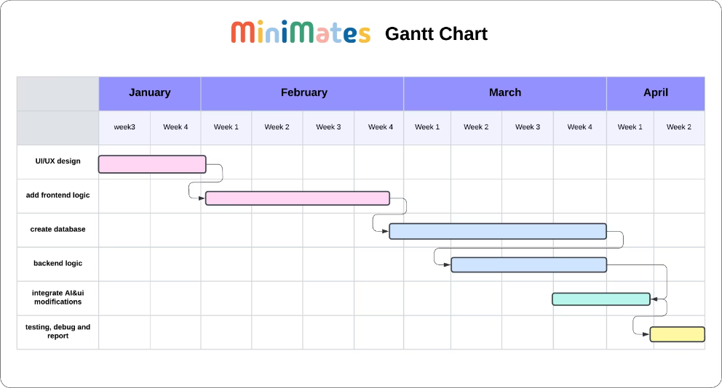
Project Timeline

Slide 10

References
Ai tools
ChatGPT for the Ui adjustment, part of the coding, debugging and reports.
https://www.tinytiestogether.com/?srsltid=AfmBOopHHFh44O7fvsY-NvQpw8PlkgaN391b08W6u6sUNia3dTrGj6zO
https://www.myplaydateapp.com/
https://www.golfburnaby.ca/search/results?keys=kids
https://www.youtube.com/watch?v=6af6qgziYfo&list=PLtIU0BH0pkKpitsp5jzt-yDAoXAFBkcPb&index=15
https://www.xiaohongshu.com/explore
https://www.meetup.com/

Slide 11


Thank you
Minimates has the potential to create a stronger sense of community, foster meaningful connections, and enrich the lives of families. By advanced technology and building a supportive environment, it can empower parents and inspire a more connected and enjoyable family life.

